Slide 1
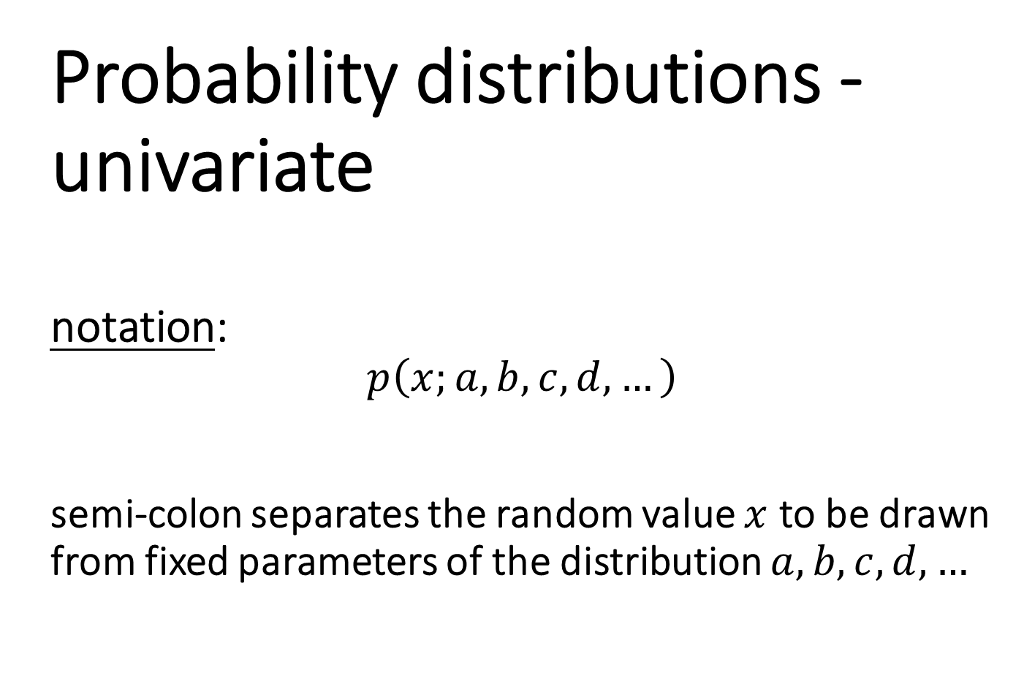
Probability distributions - univariate notation: $$p\left(x;a,b,c,d,…\right)$$ semi-colon separates the random value $x$ to be drawn from fixed parameters of the distribution $a,b,c,d,…$

Slide 2
Discrete Distributions
For those times when your variables take discrete values
Examples:
Small Businesses
Number of arrivals in a time period
Industry
Demand (number of sales) is discrete
Transportation
Number of cars passing in a time interval

Slide 3
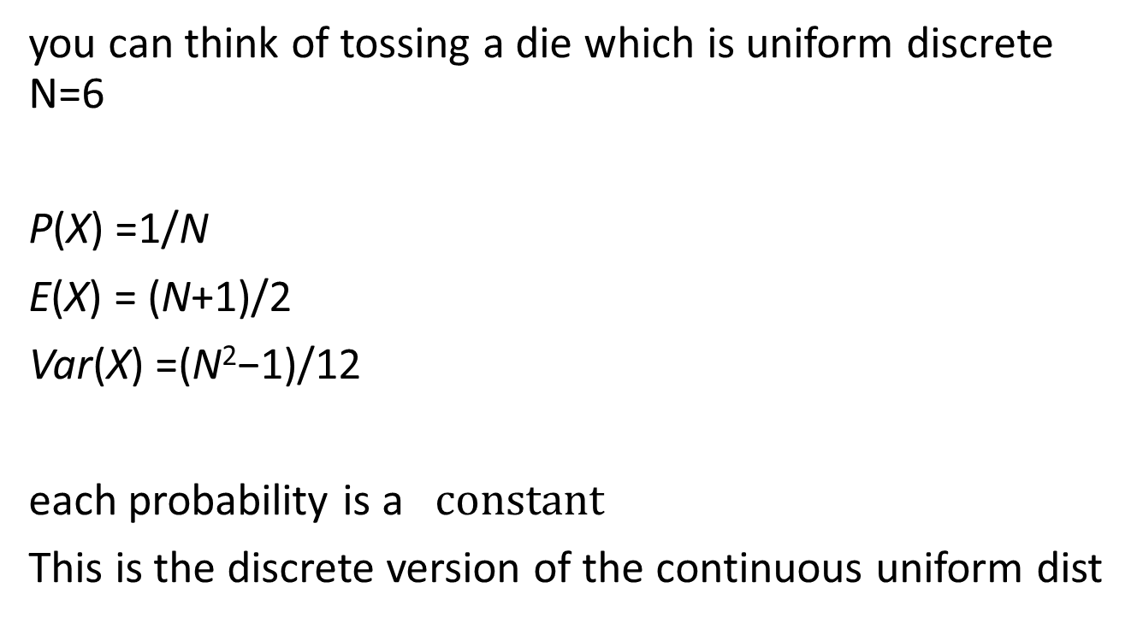
Uniform Discrete
you can think of tossing a die which is uniform discrete N=6
P(X) =1/N
E(X) = (N+1)/2
Var(X) =(N²−1)/12
each probability is a $constant$
This is the discrete version of the continuous uniform dist
Notes:
Draw picture on chalkboard

Slide 4
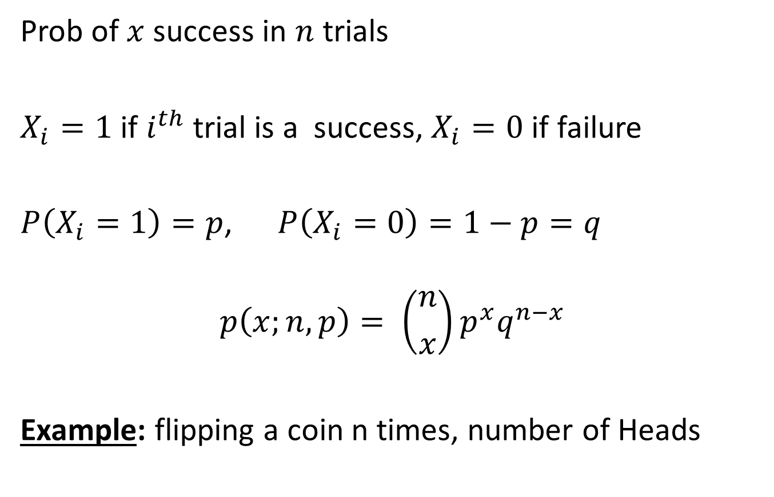
Binomial
Prob of $x$ success in $n$ trials
$X_{i}=1$ if $i^{th}$ trial is a success, $X_{i}=0$ if failure
$P\left(X_{i}=1\right)=p$, $P\left(X_{i}=0\right)=1−p=q$
$$p\left(x;n,p\right)= \left({n \atop x}\right)p^{x}q^{n−x}$$
Example: flipping a coin n times, number of Heads

Slide 5
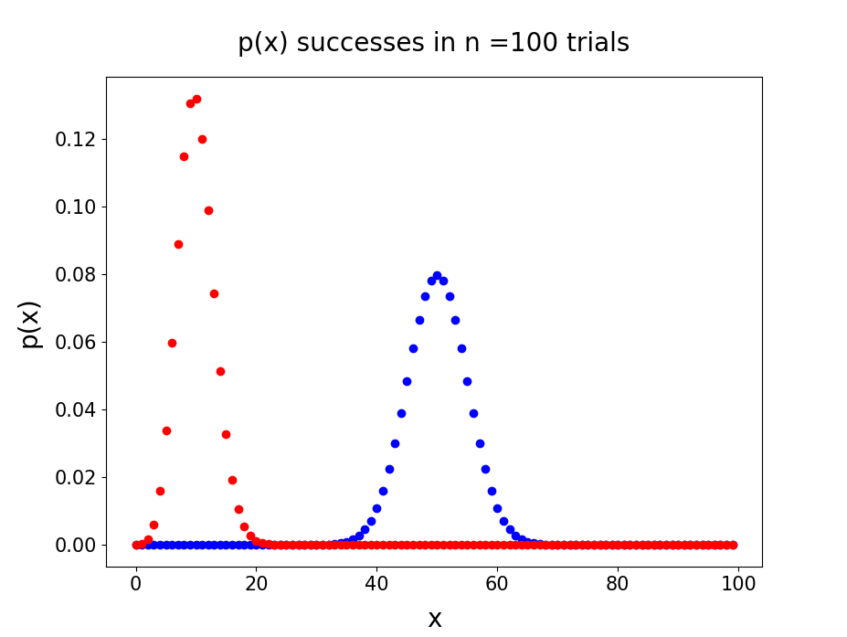
p = 0.5
p = 0.1
tends to normal distribution for large n

Slide 6
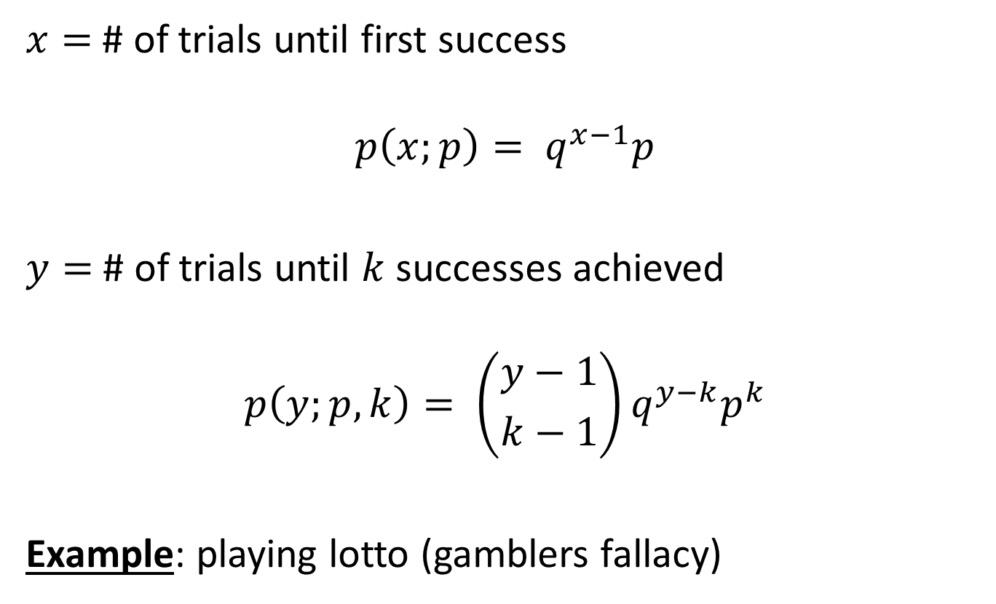
Geometric & Neg-Binomial
$x=$ # of trials until first success
$$p\left(x;p\right)= q^{x−1}p$$
$y=$ # of trials until $k$ successes achieved
$$p\left(y;p,k\right)= \left({y−1 \atop k−1}\right)q^{y−k}p^{k}$$
Example: playing lotto (gamblers fallacy)

Slide 7
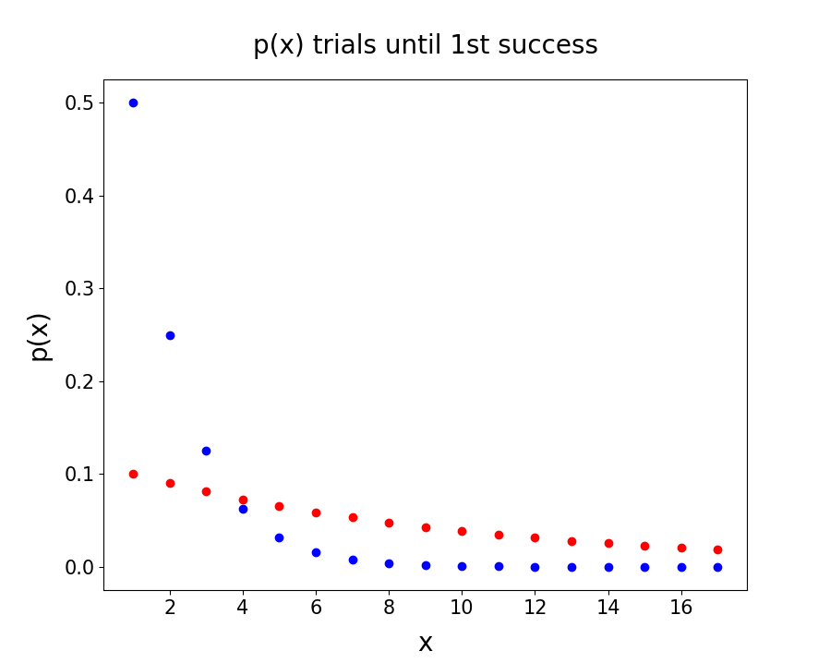
p = 0.5
p = 0.1

Slide 8
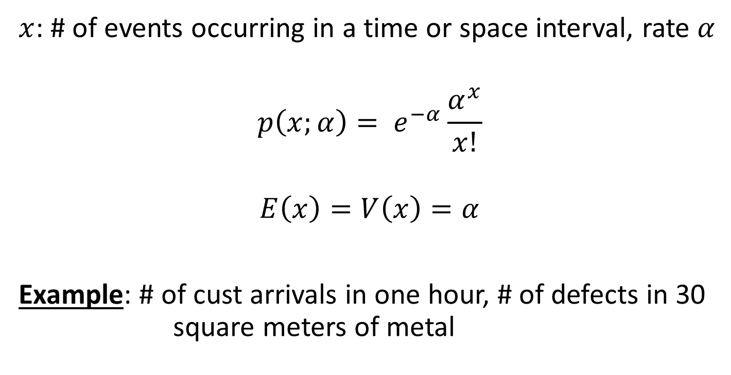
Poisson
$x$: # of events occurring in a time or space interval, rate $α$
$$p\left(x;α\right)= e^{−α}\frac{α^{x}}{x!}$$
$$E\left(x\right)=V\left(x\right)=α$$
Example: # of cust arrivals in one hour, # of defects in 30 square meters of metal

Slide 9
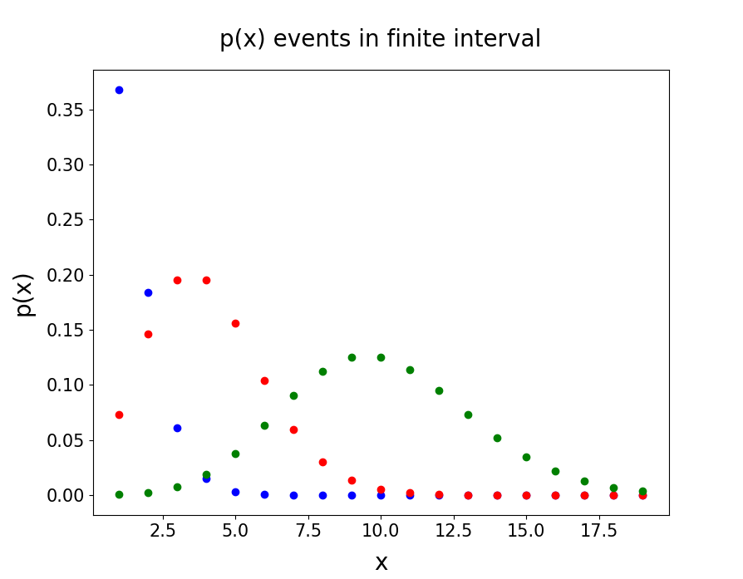
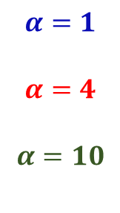
$$α=1$$
$$α=4$$
$$α=10$$

Slide 10
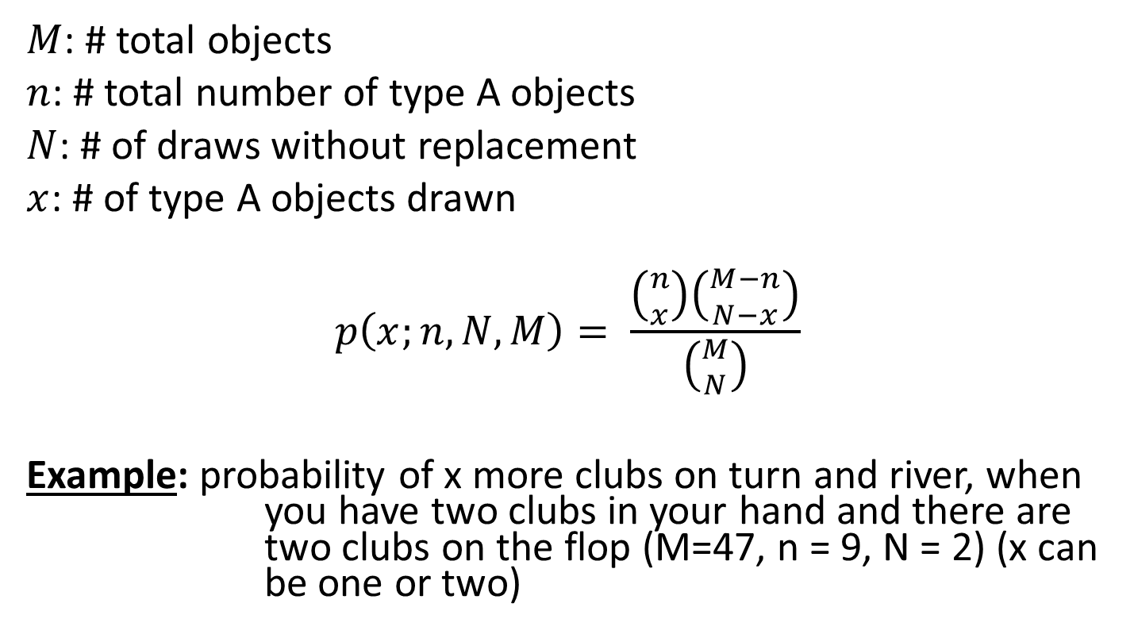
Hypergeometric (binomial w/out replacement)
$M$: # total objects
$n$: # total number of type A objects
$N$: # of draws without replacement
$x$: # of type A objects drawn
$$p\left(x;n,N,M\right)= \frac{\left({n \atop x}\right)\left({M−n \atop N−x}\right)}{\left({M \atop N}\right)}$$
Example: probability of x more clubs on turn and river, when you have two clubs in your hand and there are two clubs on the flop (M=47, n = 9, N = 2) (x can be one or two)

Slide 11
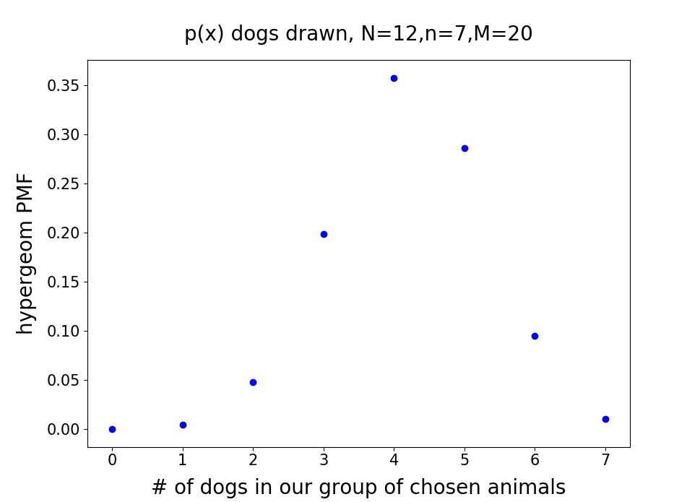

Slide 12
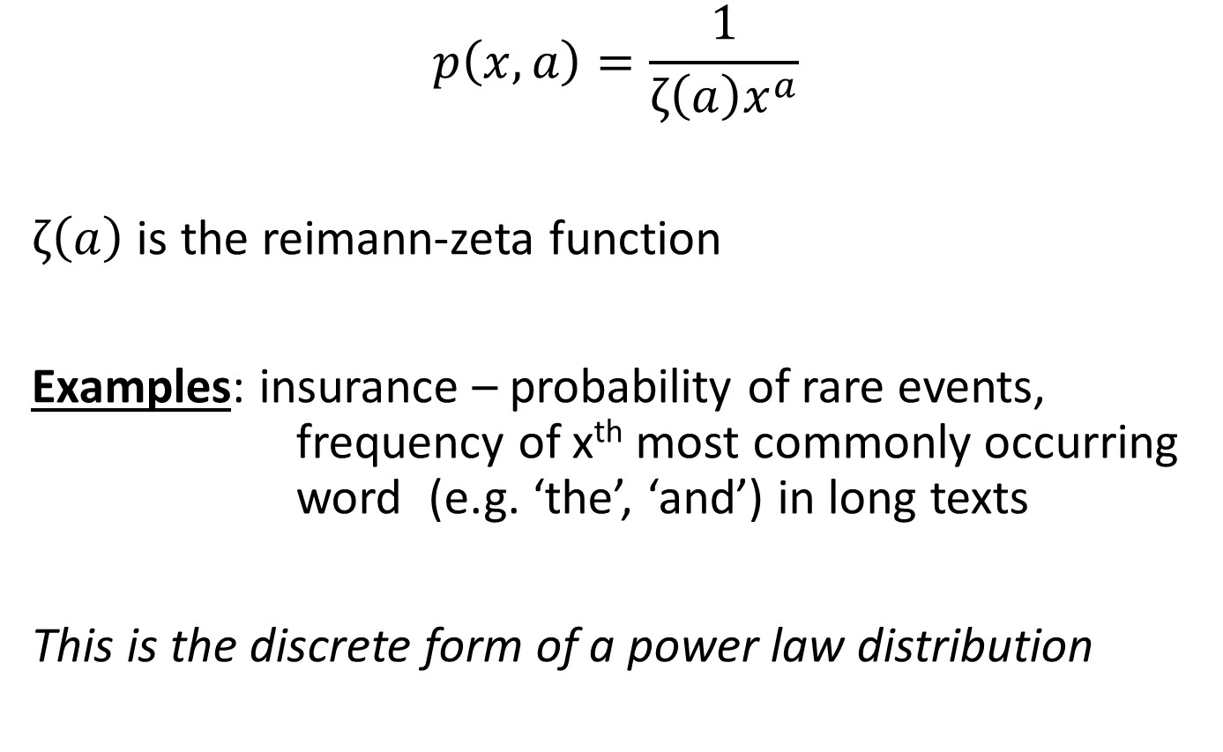
Zipf
$$p\left(x,a\right)=\frac{1}{ζ\left(a\right)x^{a}}$$
$ζ\left(a\right)$ is the reimann-zeta function
Examples: insurance – probability of rare events, frequency of x^{th} most commonly occurring word (e.g. ‘the’, ‘and’) in long texts
This is the discrete form of a power law distribution

Slide 13
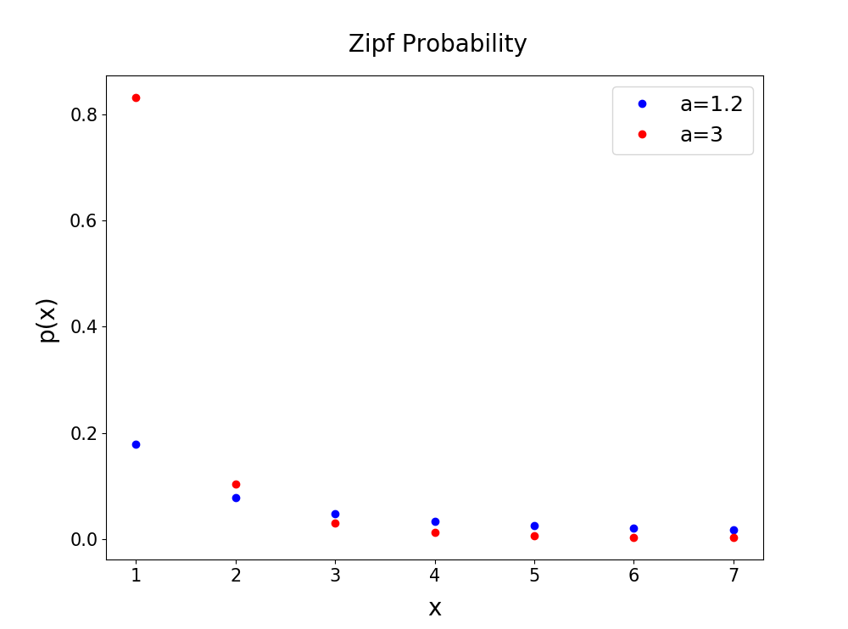
to see the structure and tail of the distributions use log-log plot

Slide 14
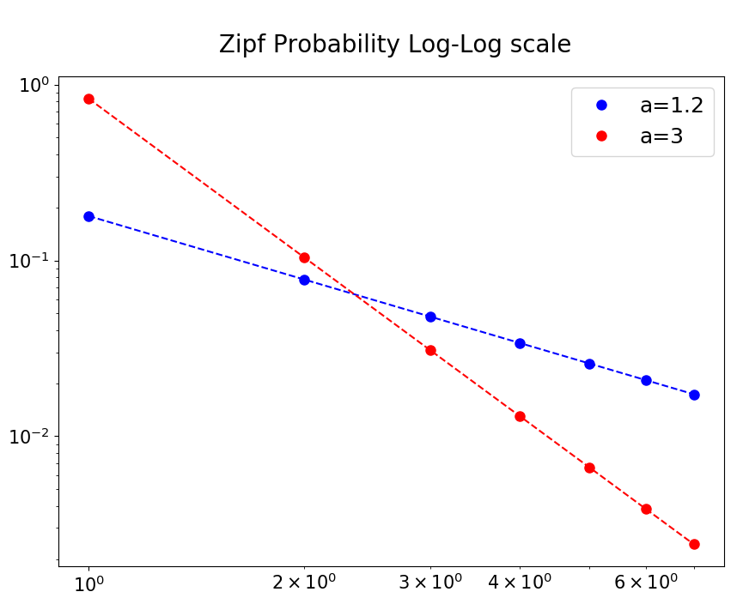
If you plot your data on log-log scale and you get straight lines that could
mean you are dealing with a power law distribution

Slide 15
Continuous distributions
Continuous range valued variables
Examples:
Process times (times are usually continuous)
Spatial locations of deformities (space is continuous)

Slide 16
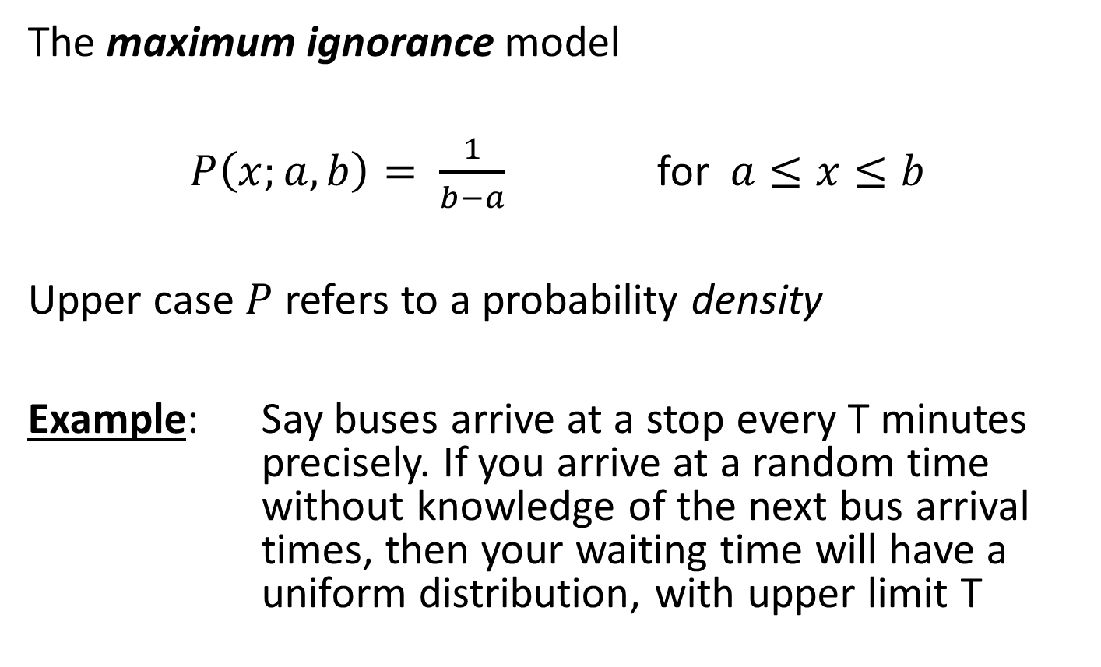
Uniform
The maximum ignorance model
$P\left(x;a,b\right)= \frac{1}{b−a}$ for $a≤x≤b$
Upper case $P$ refers to a probability density
Example: Say buses arrive at a stop every T minutes precisely. If you arrive at a random time without knowledge of the next bus arrival times, then your waiting time will have a uniform distribution, with upper limit T

Slide 17
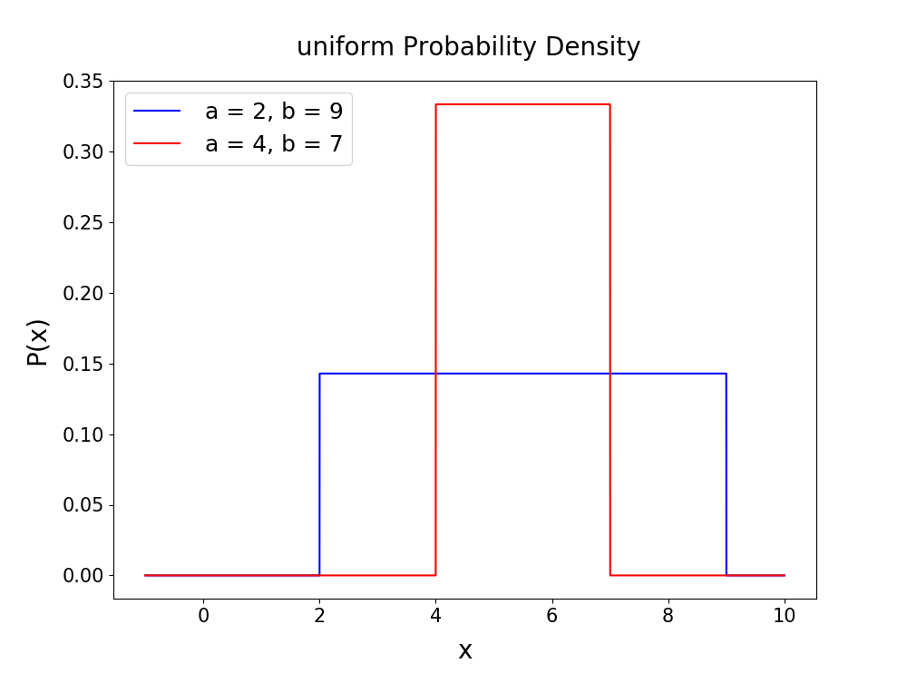

Slide 18
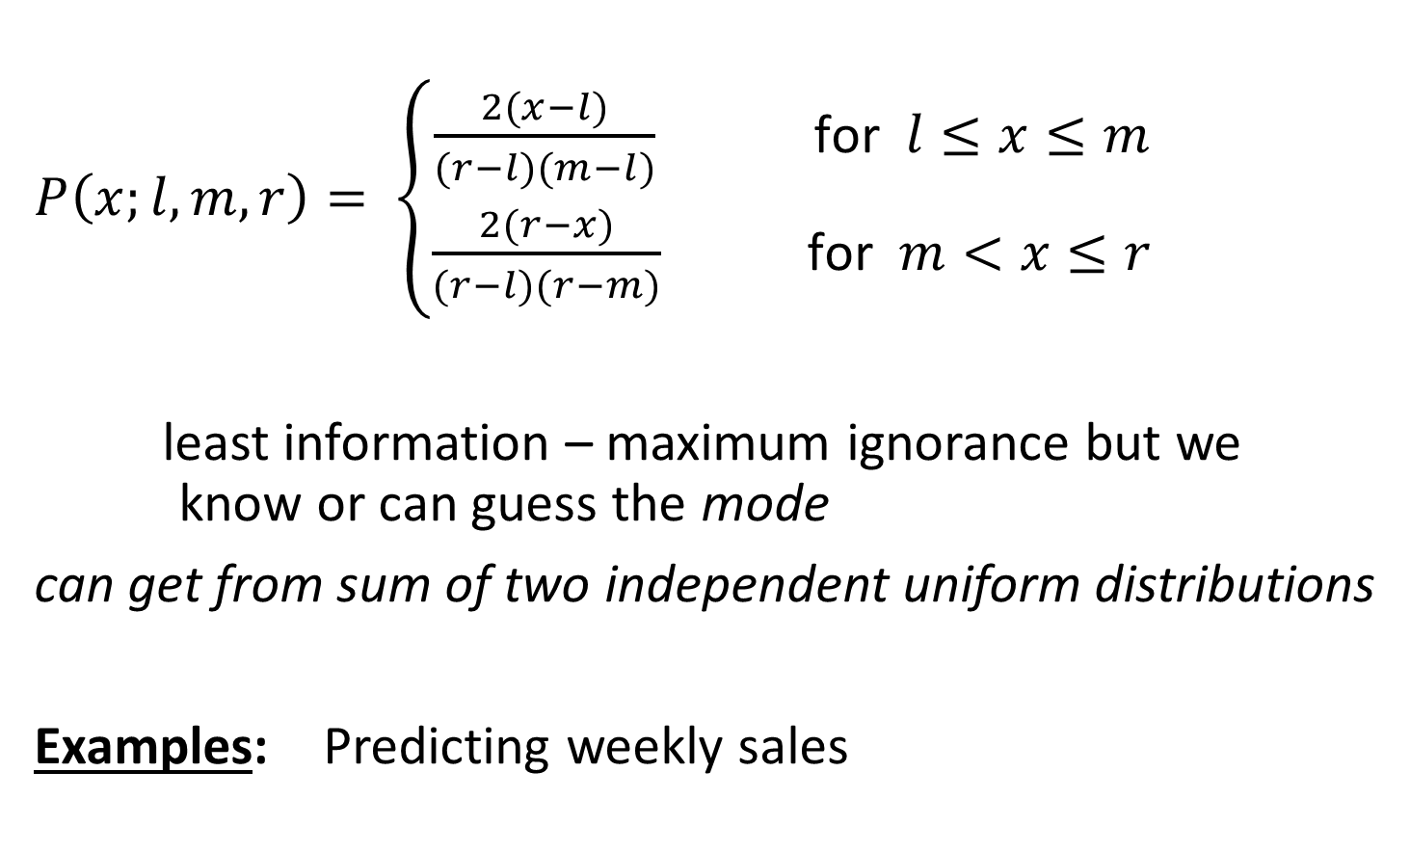
Triangular
$P\left(x;l,m,r\right)= \left\{\begin{aligned}\frac{2(x−l)}{(r−l)(m−l)} \text{for} l≤x≤m \\ \frac{2(r−x)}{(r−l)(r−m)} \text{for} m<x≤r\end{aligned}\right.$
least information – maximum ignorance but we know or can guess the mode
can get from sum of two independent uniform distributions
Examples: Predicting weekly sales

Slide 19
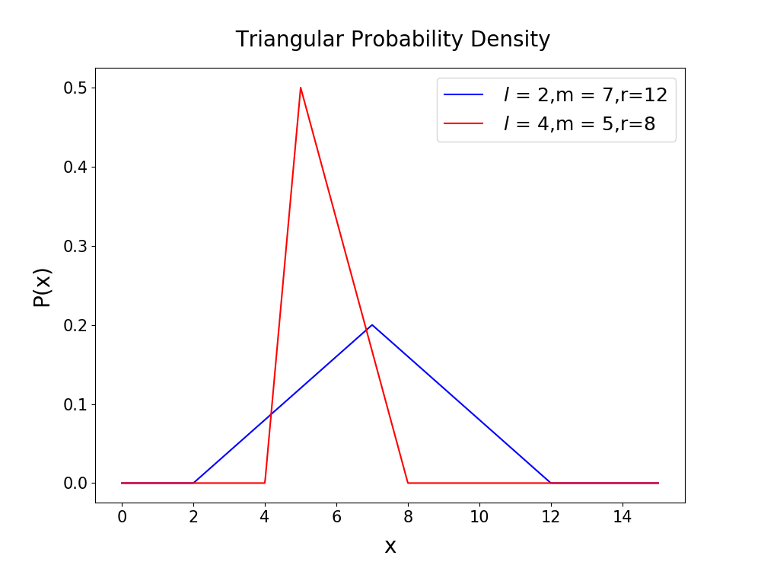

Slide 20
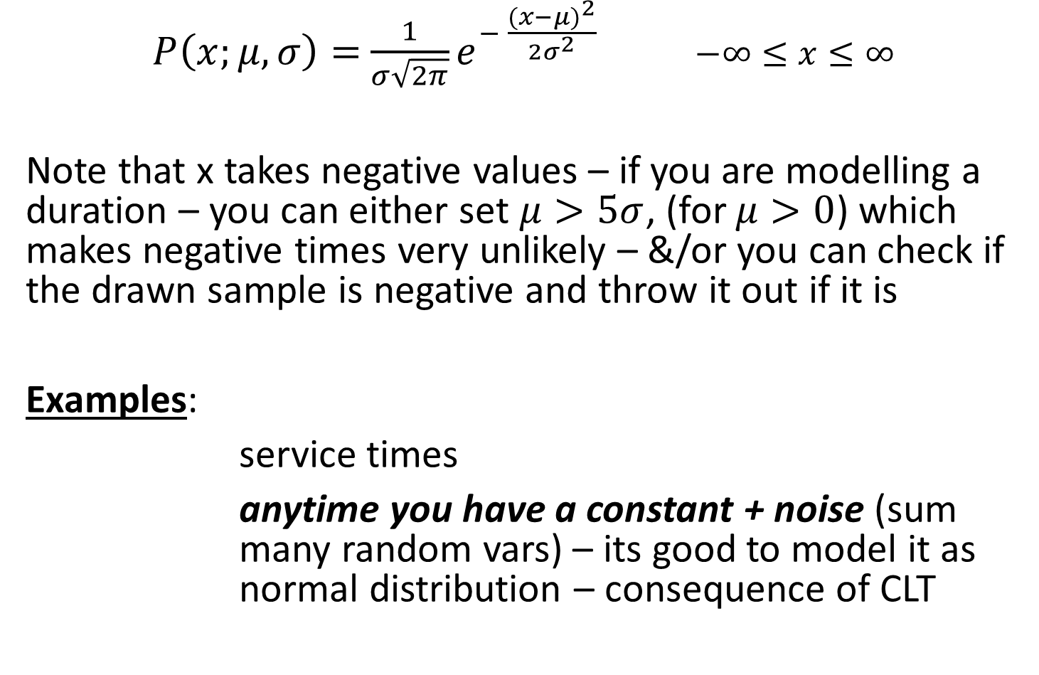
Normal
$P\left(x;μ,σ\right)=$ ${\frac{1}{σ\sqrt{2π}}e}^{− \frac{{(x−μ)}^{2}}{2σ^{2}}}$ $−∞≤x≤∞$
Note that x takes negative values – if you are modelling a duration – you can either set $μ>5σ$, (for $μ>0$) which makes negative times very unlikely – &/or you can check if the drawn sample is negative and throw it out if it is
Examples:
service times
anytime you have a constant + noise (sum many random vars) – its good to model it as normal distribution – consequence of CLT

Slide 21
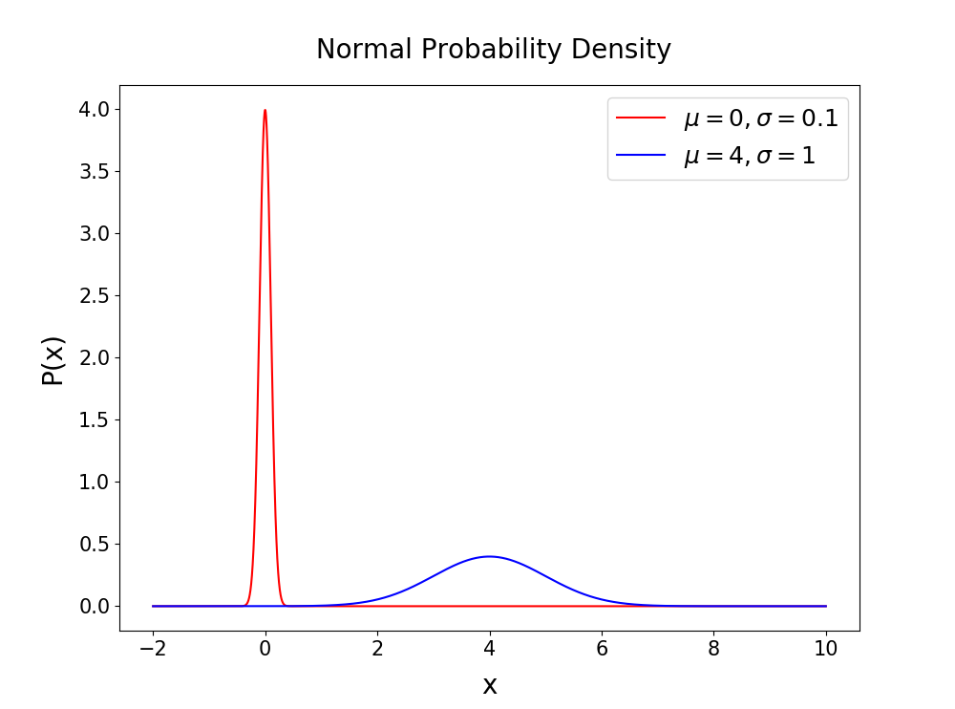

Slide 22
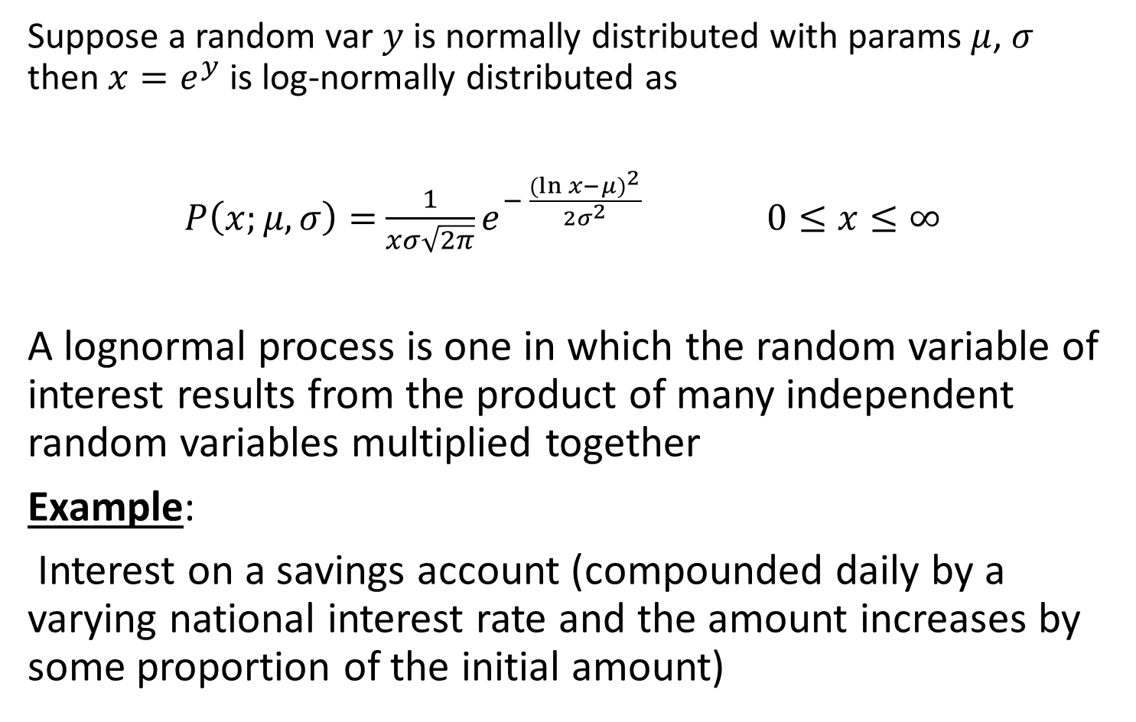
Lognormal
Suppose a random var $y$ is normally distributed with params $μ$, $σ$ then $x=e^{y}$ is log-normally distributed as
$P\left(x;μ,σ\right)=$ ${\frac{1}{xσ\sqrt{2π}}e}^{− \frac{{(\ln{x}−μ)}^{2}}{2σ^{2}}}$ $0≤x≤∞$
A lognormal process is one in which the random variable of interest results from the product of many independent random variables multiplied together
Example:
Interest on a savings account (compounded daily by a varying national interest rate and the amount increases by some proportion of the initial amount)

Slide 23
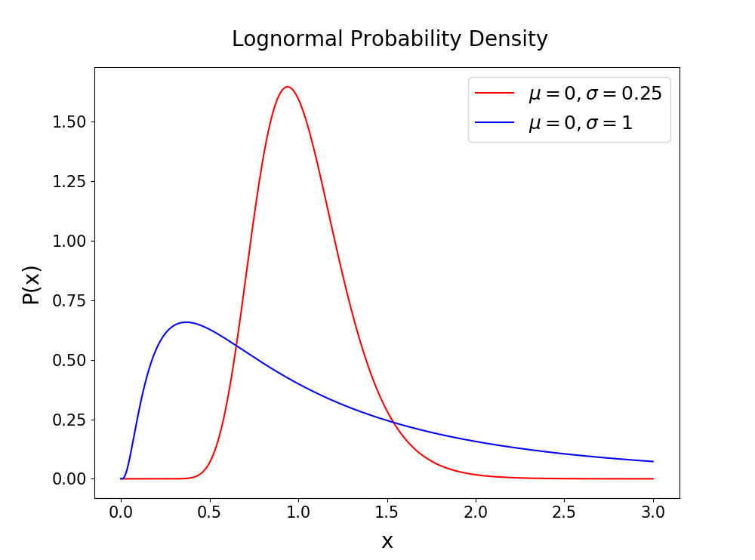

Slide 24
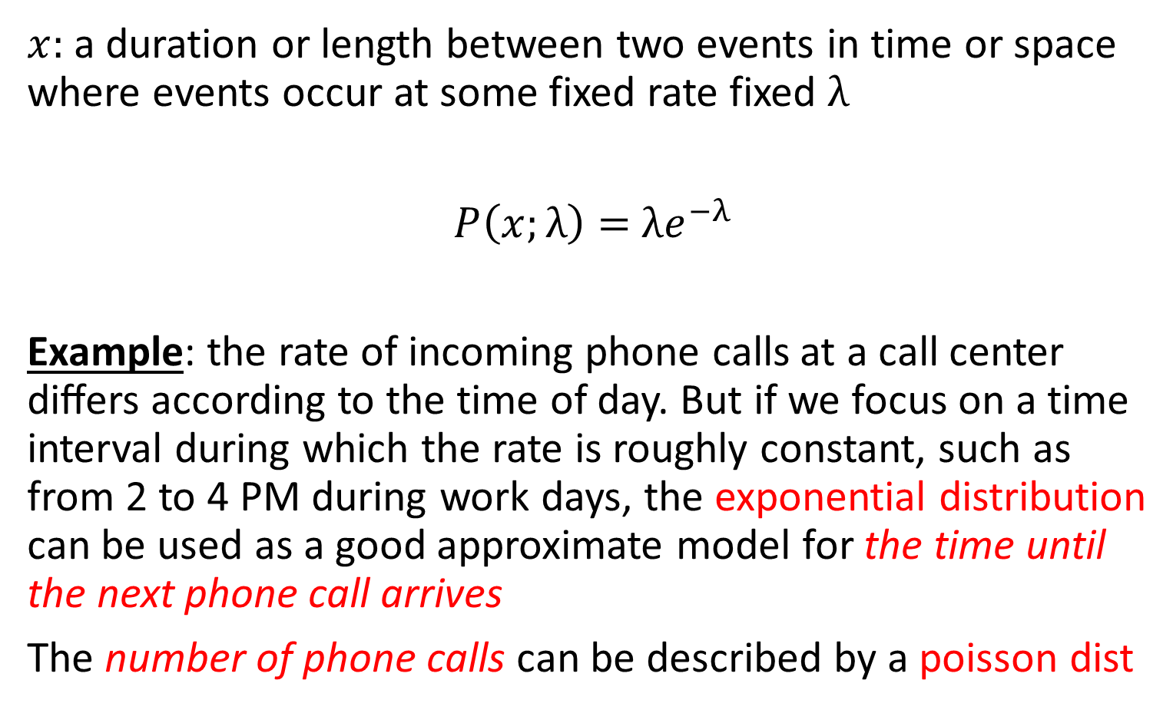
Exponential
$x$: a duration or length between two events in time or space where events occur at some fixed rate fixed $λ$
$P\left(x;λ\right)=$ $λe^{−λ}$
Example: the rate of incoming phone calls at a call center diﬀers according to the time of day. But if we focus on a time interval during which the rate is roughly constant, such as from 2 to 4 PM during work days, the exponential distribution can be used as a good approximate model for the time until the next phone call arrives
The number of phone calls can be described by a poisson dist

Slide 25
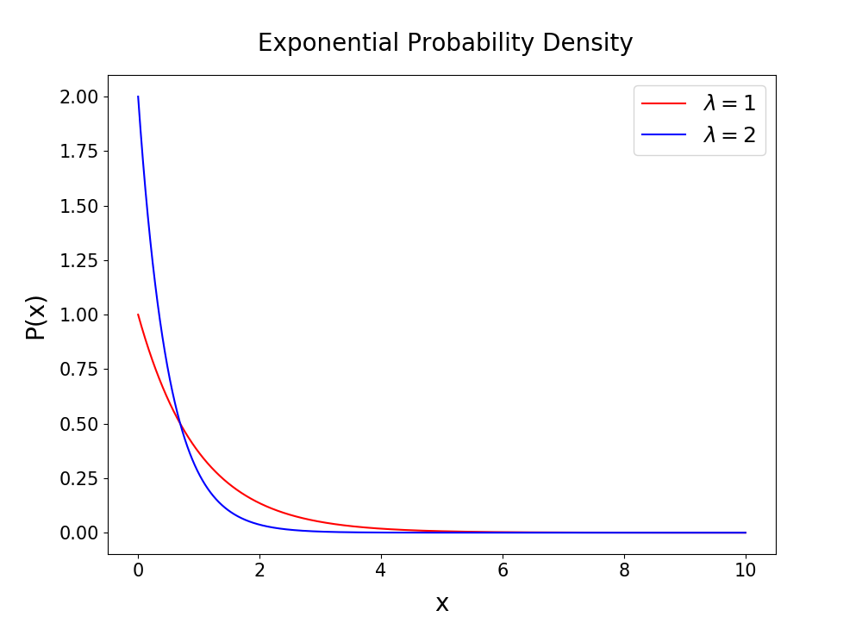

Slide 26
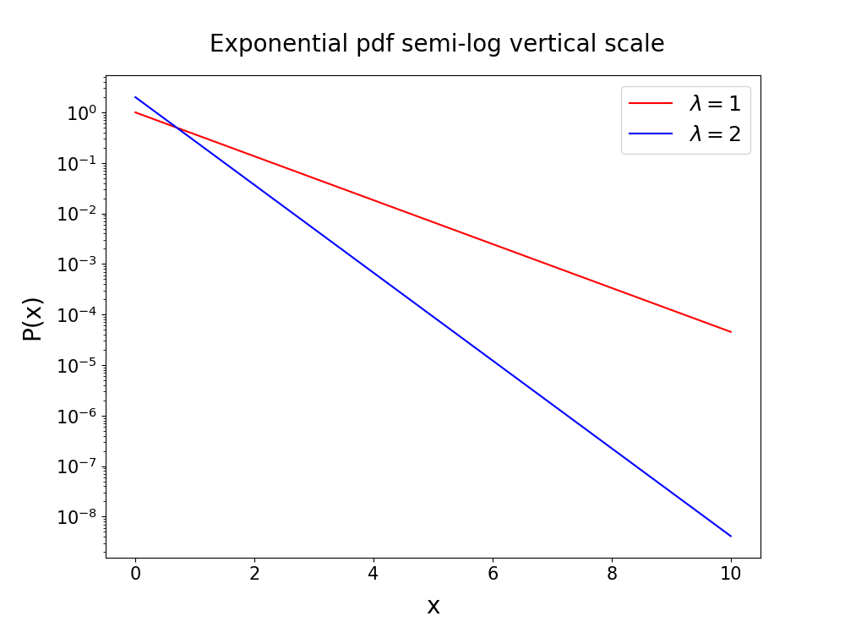
If your data on semi-log vertical scale give straight line then u might be dealing with an exponential distribution

Slide 27
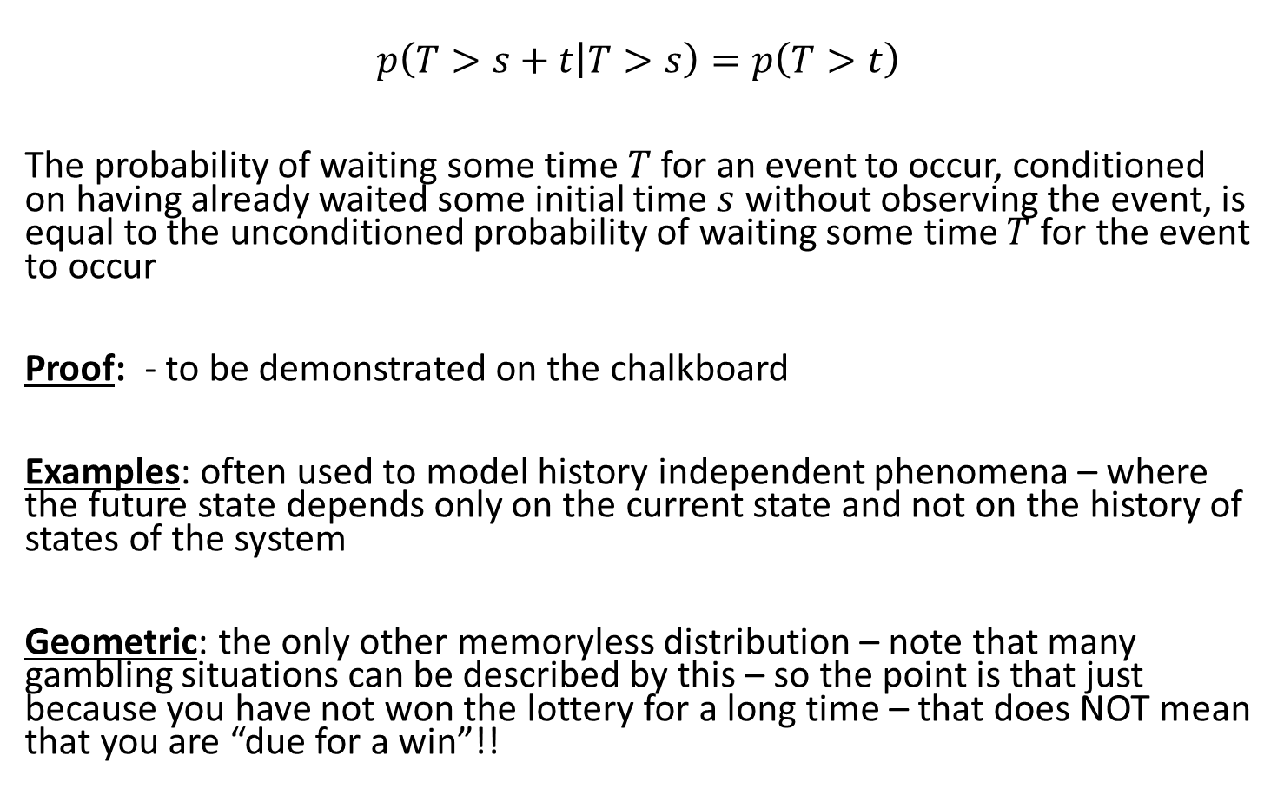
Memorylessness Property of exp dist
$$p\left(T>s+t | T>s\right)=p\left(T>t\right)$$
The probability of waiting some time $T$ for an event to occur, conditioned on having already waited some initial time $s$ without observing the event, is equal to the unconditioned probability of waiting some time $T$ for the event to occur
Proof: - to be demonstrated on the chalkboard
Examples: often used to model history independent phenomena – where the future state depends only on the current state and not on the history of states of the system
Geometric: the only other memoryless distribution – note that many gambling situations can be described by this – so the point is that just because you have not won the lottery for a long time – that does NOT mean that you are “due for a win”!!

Slide 28
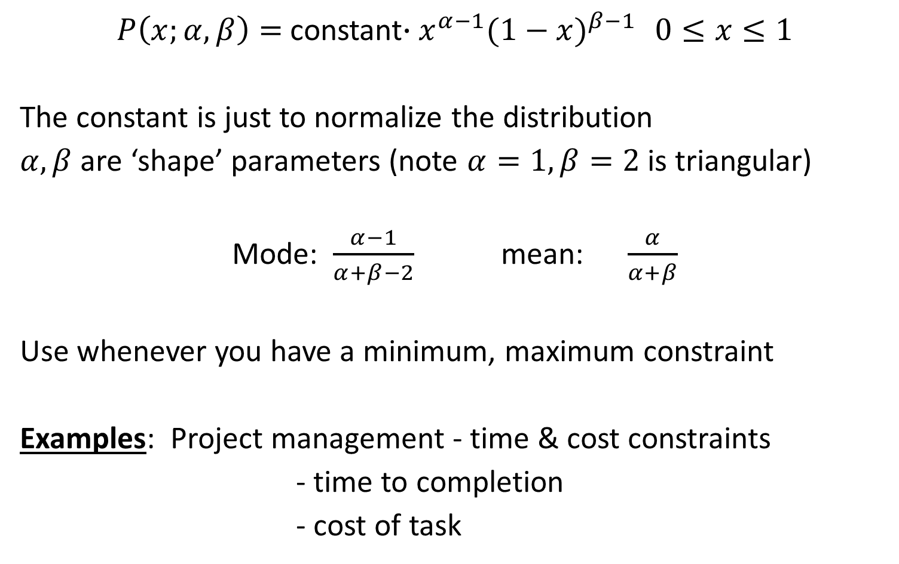
Beta
$P\left(x;α,β\right)=$constant$∙x^{α−1}{(1−x)}^{β−1}$ $0≤x≤1$
The constant is just to normalize the distribution
$α,β$ are ‘shape’ parameters (note $α=1,β=2$ is triangular)
Mode: $\frac{α−1}{α+β−2}$ mean: $\frac{α}{α+β}$
Use whenever you have a minimum, maximum constraint
Examples: Project management - time & cost constraints
- time to completion
- cost of task

Slide 29
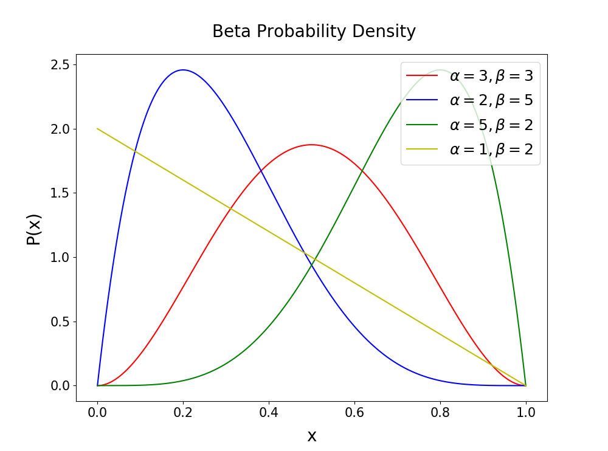
Notice the symmetries

Slide 30
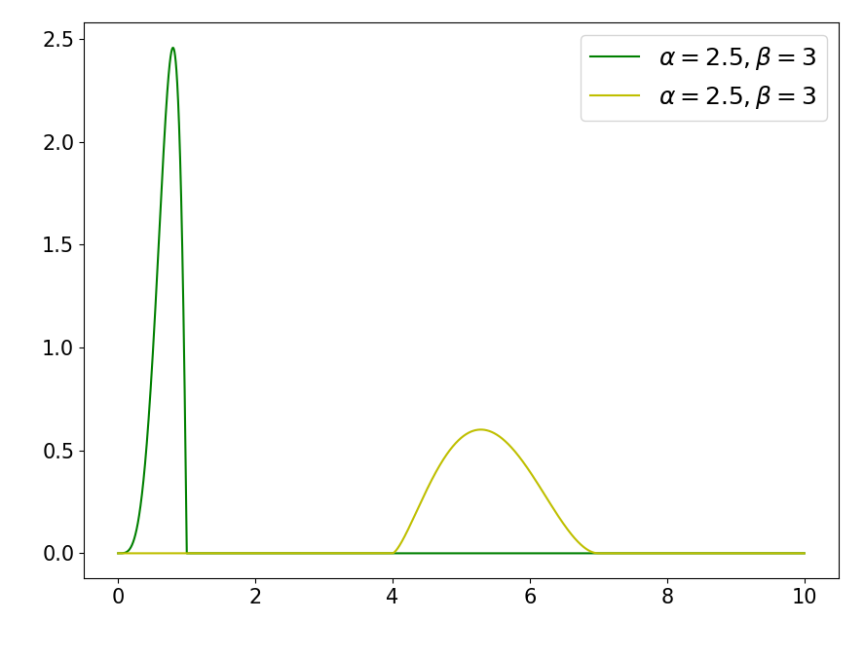
Beta dist is defined on [0,1] but you can SCALE or TRANSLATE

Slide 31
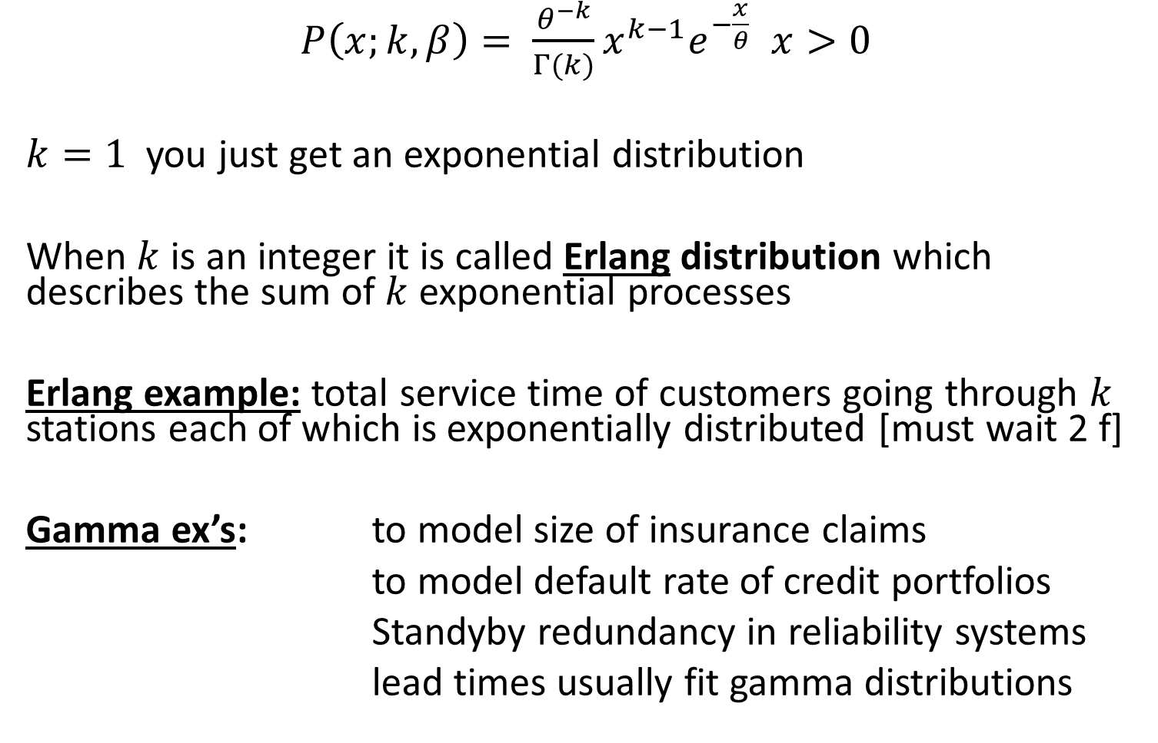
Gamma
$P\left(x;k,β\right)= \frac{θ^{−k}}{Γ(k)}x^{k−1}e^{−\frac{x}{θ}}$ $x>0$
$k=1$ you just get an exponential distribution
When $k$ is an integer it is called Erlang distribution which describes the sum of $k$ exponential processes
Erlang example: total service time of customers going through $k$ stations each of which is exponentially distributed [must wait 2 f]
Gamma ex’s: to model size of insurance claims
to model default rate of credit portfolios
Standyby redundancy in reliability systems
lead times usually fit gamma distributions

Slide 32
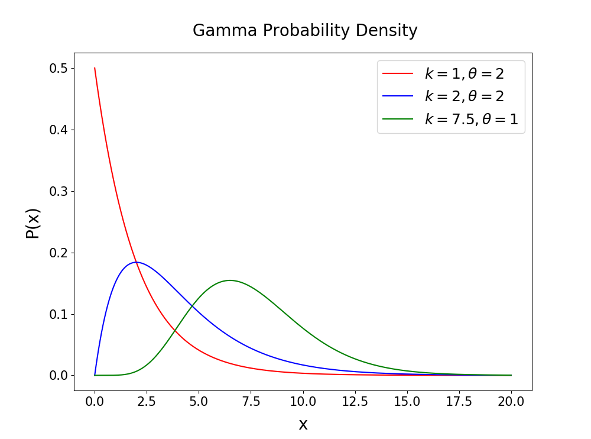

Slide 33
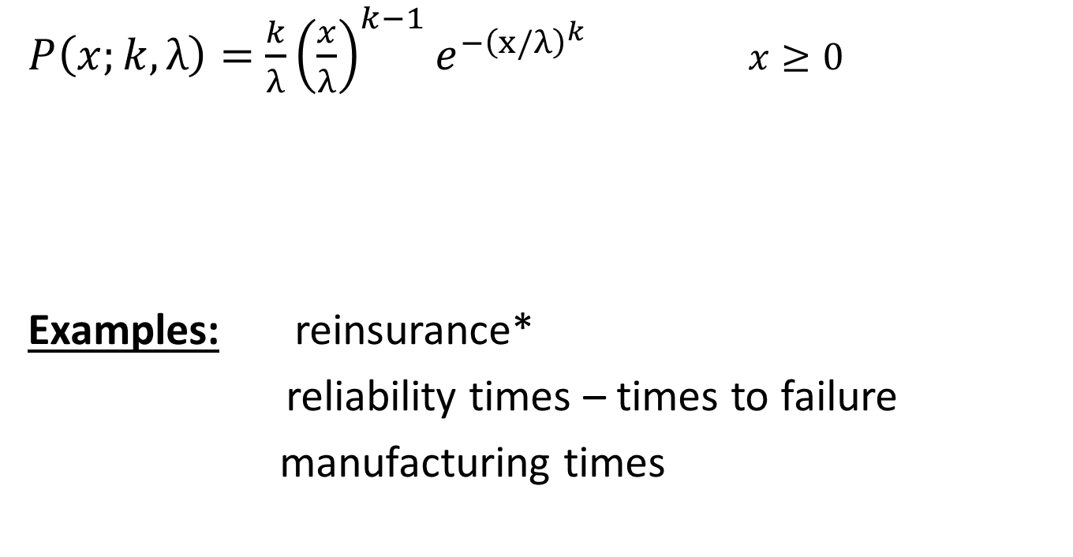
Weibull
$P\left(x;k,λ\right)=$ ${\frac{k}{λ}{\left(\frac{x}{λ}\right)}^{k−1}e}^{−{\left(x/λ\right)}^{k}}$ $x≥0$
Examples: reinsurance*
reliability times – times to failure
manufacturing times

Slide 34
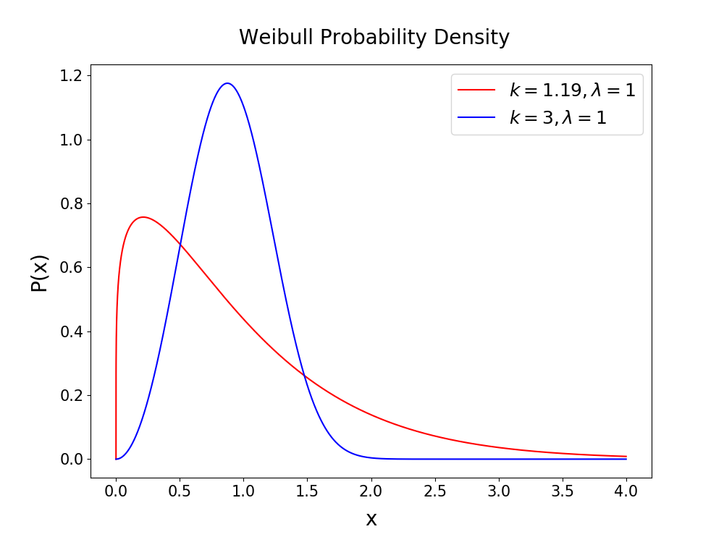

Slide 35
Differences Between exp, gamma & Weibull distributions
All are used to model various interarrival, service or various industrial time durations
Main differences are in:
Location of Modes
Shapes of tails
Exponential has mode at the origin, but for gamma and Weibull, the mode depends on the parameters
Gamma is long-tailed like exponential
Tail of Weibull is flexible – can vanish slow or fast depending on parameters – use for long service times

Slide 36
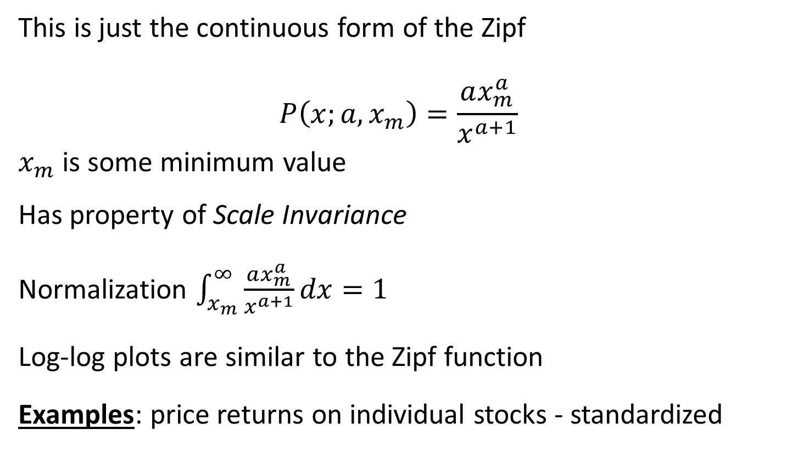
Pareto
This is just the continuous form of the Zipf
$$P\left(x;a,x_{m}\right)=\frac{ax_{m}^{a}}{x^{a+1}}$$
$x_{m}$ is some minimum value
Has property of Scale Invariance
Normalization $\int_{x_{m}}^{∞}{\frac{ax_{m}^{a}}{x^{a+1}}}dx=1$
Log-log plots are similar to the Zipf function
Examples: price returns on individual stocks - standardized

Slide 37
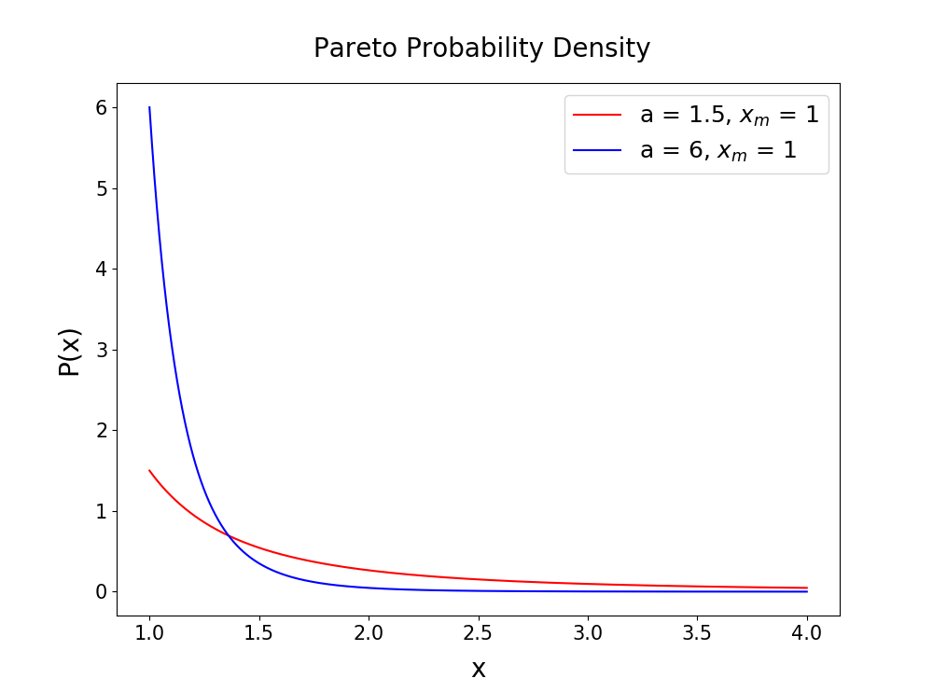

Slide 38
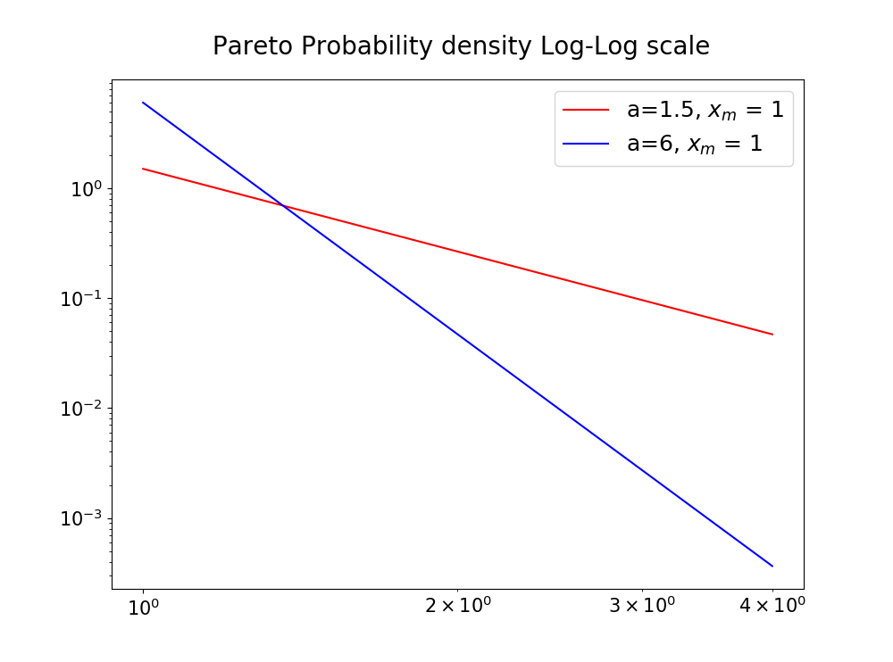

Slide 39
Modelling Discrete random vars
When the process is long-tailed,
Use:
Geometric, negative-binomial
When process is short-tailed,
Use:
Poisson dist – (fewer large demands)

Slide 40
Limited Data
Use:
Uniform – maximum ignorance dist
Triangular – max ignorance with mode
Beta – more flexible ignorant dists

Slide 41
How to choose
Is my process discrete or continuous?
Is it bounded or are there no natural bounds?

Slide 42
Empirical Distributions
Resample from the collected data
Use when no theoretical model seems appropriate

Slide 43
numpy.random.__ vs scipy.stats.__.pdf
numpy.random.binomial(n,p,100) gives you 100 samples from the uniform distribution
If you then plot a histogram of these samples should resemble the pmf
scipy.stats.binom.pmf(x,n,p) gives the exact probabilities (for all values of x)
USE scipy.stats.__.pdf to model your distribution
USE numpy.random.__ to sample your distribution
*Interactive example*

Slide 44
Poisson Process
chalkboard

